Slide 1

Steps to set up a clinical NLP study
Sumithra Velupillai

Slide 2
Natural Language Processing - workflow
Data
Understand your data - What data do you have?
How much data do you have?
Where does the data come from?
What do you want to model/extract?
Research the field:
Are there any studies where this problem has been modeled already?
Are there any existing resources (lexicons, algorithms, etc) that have already modeled something similar? Can these be useful for your problem?
Is your data appropriate for this problem?
Define problem/concept
Create gold standard
Develop NLP solution
Evaluate
Deployment

Slide 3
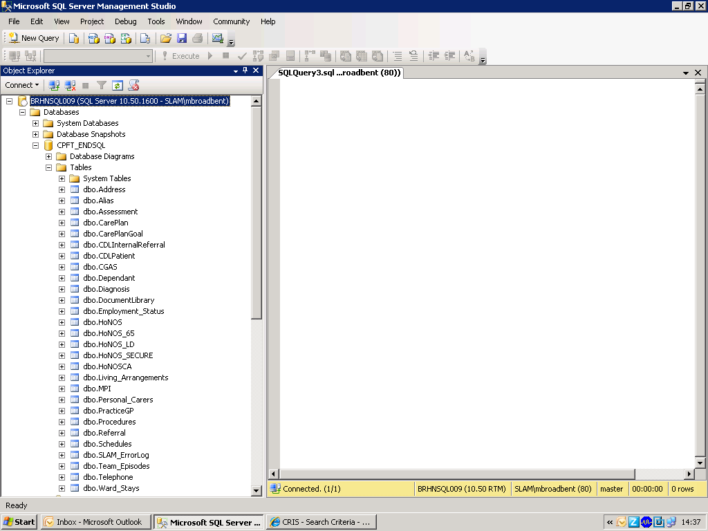
Using CRIS – CRIS SQL
Read-only access to CRIS SQL at: BRHNSQL009.CPFT_ENDSQL
CPFT_ENDSQL: one table for each ‘form’. One column for each ‘field’

Slide 4
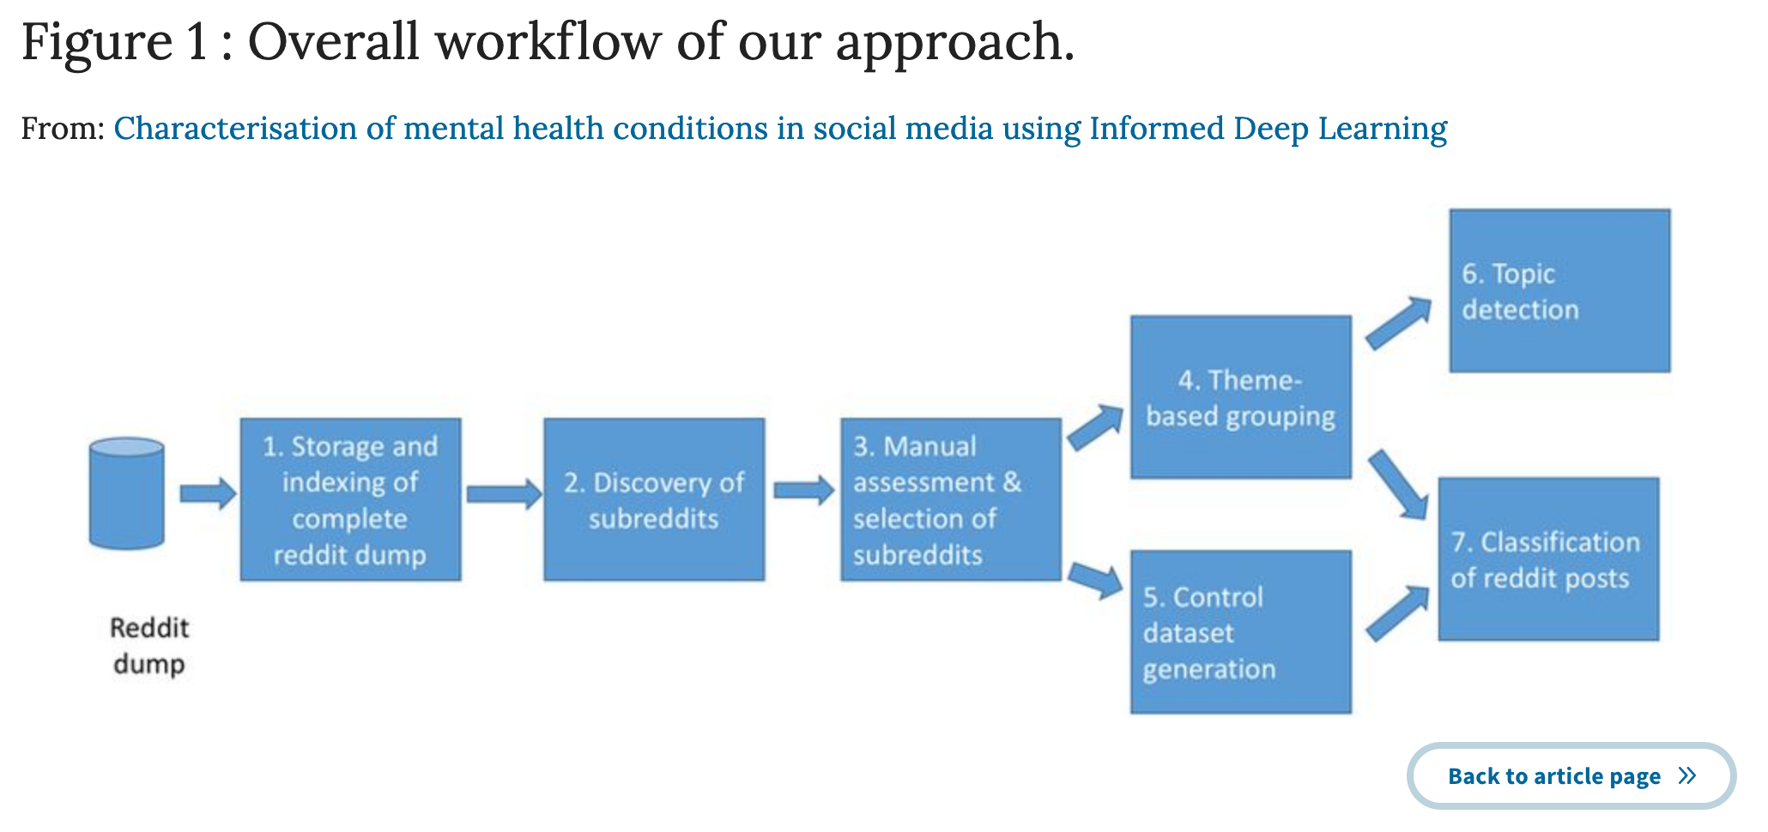
Gkotsis et al. Characterisation of mental health conditions in social media using Informed Deep Learning.
Scientific Reports volume 7, Article number: 45141 (2017)

Slide 5
Natural Language Processing - workflow
Data
Define the problem/concept
Relate to existing definitions (if any)
Determine what unit you need to model this problem
Patient? Document? Phrase? Something else?
Is NLP needed for all, or parts of the problem?
Construct your dataset based on your requirements
Look at distributions, characterise the data
Define problem/concept
Create gold standard
Develop NLP solution
Evaluate
Deployment

Slide 6
Natural Language Processing - workflow
Data
If you need to use NLP for your use-case:
Where do you expect to find the information (all documents, some documents, some parts of some documents)?
How many documents?
How long are the documents?
If your use-case also relies on other data (e.g. structured data from other database tables), is this information necessary to take into account when building your dataset?
Consult with domain experts!
Define problem/concept
Create gold standard
Develop NLP solution
Evaluate
Deployment

Slide 7
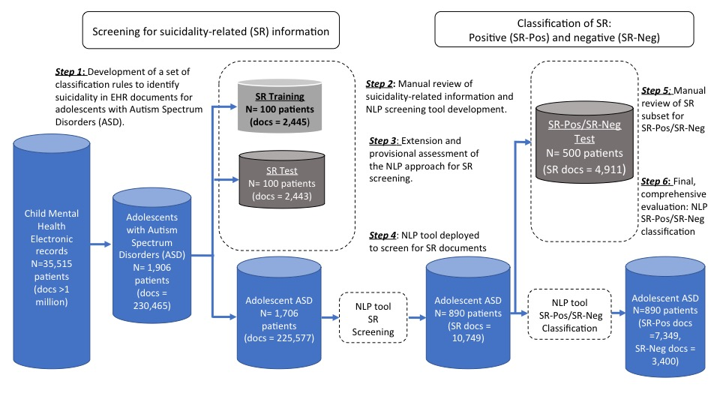
Downs et al., 2017. Detection of Suicidality in Adolescents with Autism Spectrum Disorders: Developing a Natural Language Processing Approach for Use in Electronic Health Records. In AMIA 2017 Proceedings.

Slide 8
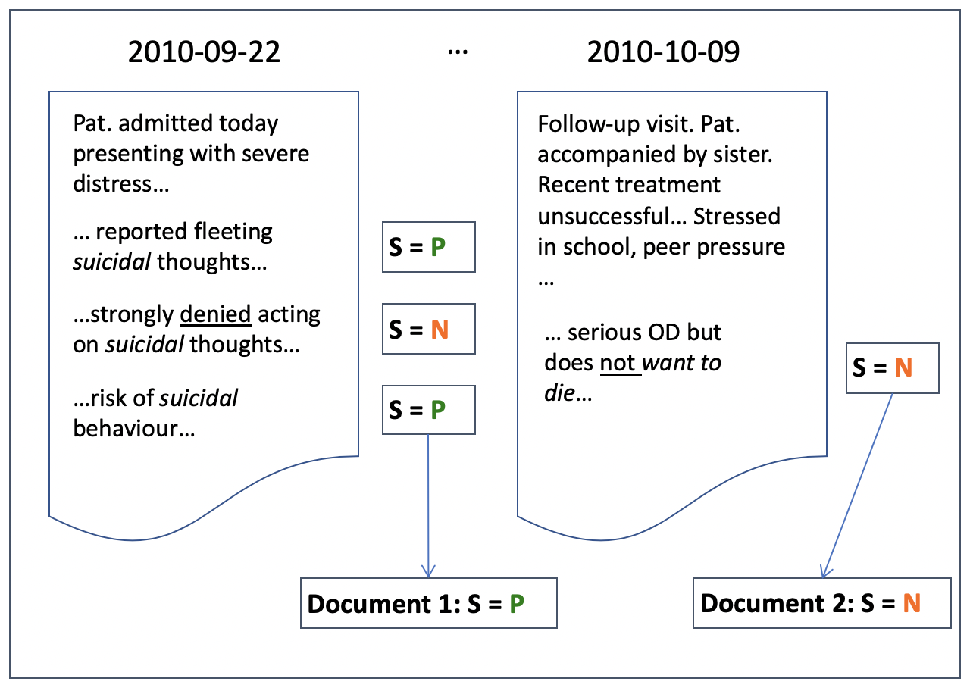


Velupillai S, Epstein S, Bittar A, et al. Identifying Suicidal Adolescents from Mental Health Records Using Natural Language Processing. Stud Health Technol Inform. 2019 Aug 21;264:413-417. doi: 10.3233/SHTI190254.
Notes:
Reference standard annotations and heuristics

Slide 9
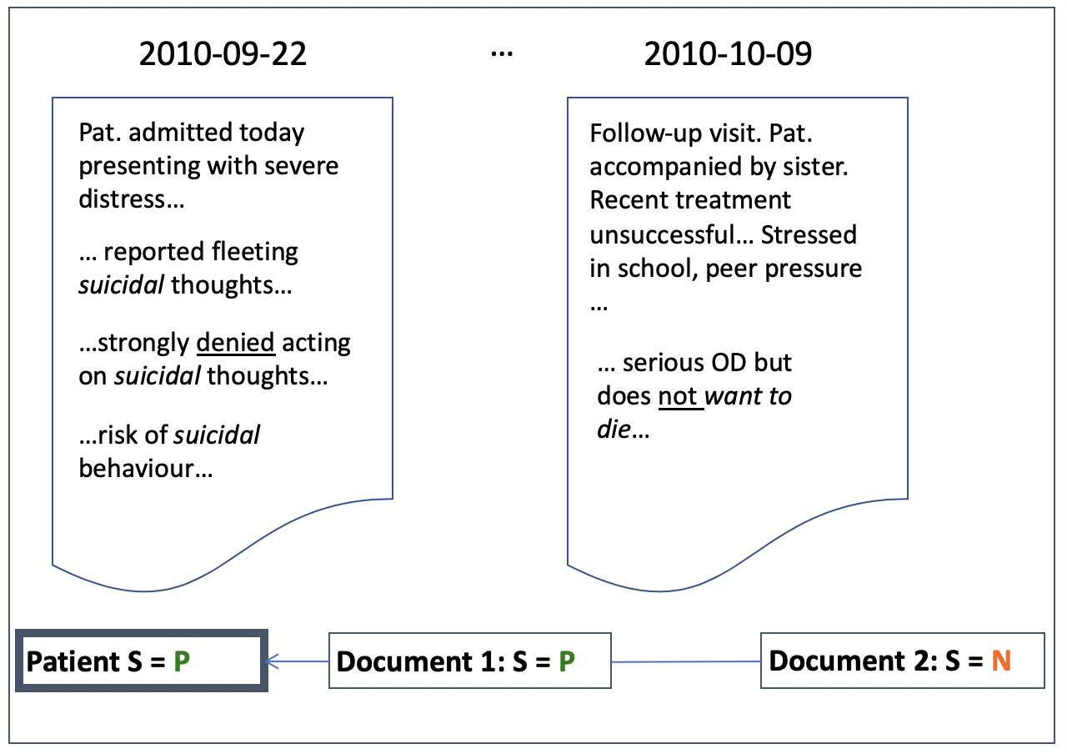

Velupillai S, Epstein S, Bittar A, et al. Identifying Suicidal Adolescents from Mental Health Records Using Natural Language Processing. Stud Health Technol Inform. 2019 Aug 21;264:413-417. doi: 10.3233/SHTI190254.
Notes:
Reference standard annotations and heuristics

Slide 10
Natural Language Processing - workflow
Data
Random sample for initial review
Worth getting a sense of the potential complexity of the task
Apply an off-the-shelf tool and look at distributions
Maybe pre-annotations can be used?
Annotation
Randomly sample the entities you need (all documents for one patient? Random documents? Random sentences?)
Extract a dataset for a first annotation round, initiate guideline development
Iterate until you’ve reached acceptable agreement and guidelines are clear.
Define problem/concept
Create gold standard
Develop NLP solution
Evaluate
Deployment

Slide 11
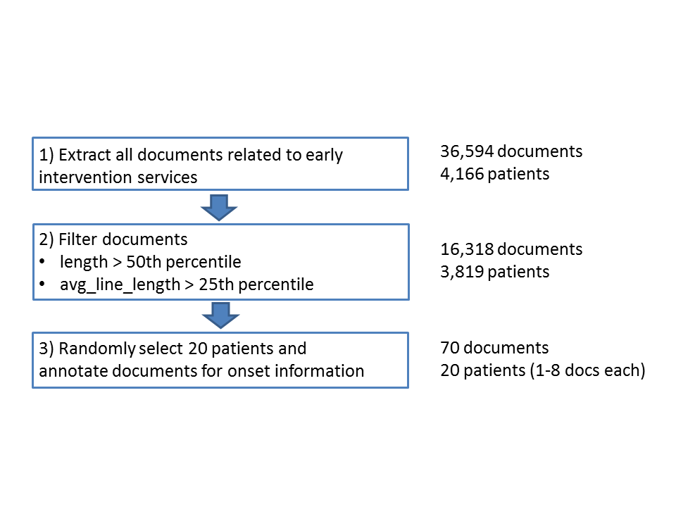
Viani et al. 2019. Annotating Temporal Relations to Determine the Onset of Psychosis Symptoms. Medinfo 2019.

Slide 12
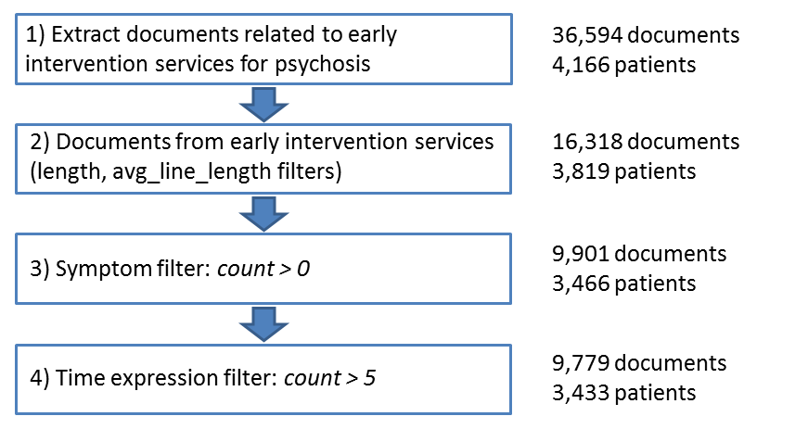
Viani et al. 2019. Temporal Information Extraction from Mental Health Records to Identify Duration of Untreated Psychosis. Under review

Slide 13
Developing a gold/reference standard corpus: Annotation
Gold/Reference standard – why?
How can manual annotations inform NLP development? (training & development)
How do we know if our NLP system does what we expect it to do? (evaluation)
How hard/easy is the task (annotator agreement, upper performance bound)

Slide 14
Developing a gold standard corpus: Annotation
Don’t underestimate this step!
“analytics tasks are often talked about as being 80% data preparation”*
Example: Penn TreeBank – widely used for NLP development
8 years of operation (1989-1996)
7 million words of PoS-tagged text, and more.
Taylor A., Marcus M., Santorini B. (2003) The Penn Treebank: An Overview. In: Abeillé A. (eds) Treebanks. Text, Speech and Language Technology, vol 20. Springer, Dordrecht
*https://www.kdnuggets.com/2017/12/general-approach-preprocessing-text-data.html

Slide 15
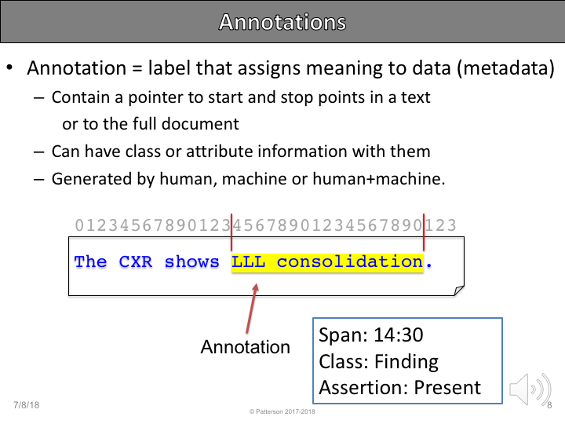
Developing a gold standard corpus: Annotation
What is annotation?
Acknowledgements: Uni. of Utah DeCART summer school: https://github.com/jianlins/AnnotationNLP/blob/master/01_Introduction_to_Annotation.ipynb

Slide 16
Annotation guidelines / Define concept
Markables – elements to be annotated
Annotation type = label to be assigned to a segment of text
Relationship = link between instances of annotations
Attributes = features of annotation types and relationships
Acknowledgements: Uni. of Utah DeCART summer school: https://github.com/jianlins/AnnotationNLP/blob/master/01_Introduction_to_Annotation.ipynb

